Slide 1
NEW ZEALAND

Slide 2
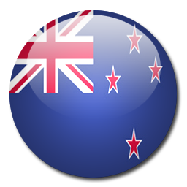
COUNTRY PRESENTATION NEW ZEALAND
PRESENTED BY: -
AMIT KUMAR
RAMEES
SHILPA
SHANGAR.C
WASEEM AKRAM

Slide 3
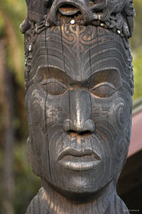
History
Abel Janszoon Tasman on 13th Dec,1642.
visited by explorers and sailors, missionaries, traders and adventurers
European -1800s, causing strife and warfare.
1830s European settlers
land was purchased and taken from the local tribes.
Notes:
First european explorer was discovered

Slide 4
Overview
Capital – Wellington
Largest city – Auckland
Language – English, Maori, sign
Government – Parliamentary Constitutional Monarchy
Monarch – Elizabeth II
Governor General – Sir Jerry Mateparae
Prime Minister – John Key
Notes:
Southern tip of north island

Slide 5
Contd.,
Ethnic Groups - European (70%) Maori (15%) Asian (9.2%) Pacific People (6.9%)
Area – 2,70,550 km²
Population -3.9
Game – Rugby
Dependent on natural resources- soil, water, and plants.
Agricultural, pastoral farming, renewable forestry and tourism.

Slide 6
Climate
Spring (6`-19`)
Summer (10’-24`)
Autumn (6`-20`)
Winter (1`-16`)

Slide 7
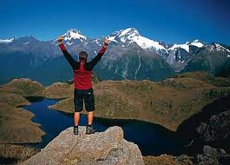
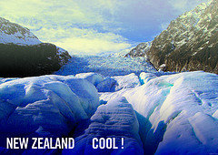
Tourism
182,000 persons are employed (9.6%)
2.5 million international travellers visited
NZ received total funding of $99 million.
Digital channels are providing the best platform
They are attract high value visitors

Slide 8
International Visitors
Country | 2009 | 2010
Australia | 1,082,680 | 1,119,879
United Kingdom | 258,438 | 234,314
United States | 197,792 | 189,709
China, People's Republic of | 102,259 | 122,712
Japan | 78,426 | 87,735
South Korea | 52,921 | 67,309
Germany | 64,564 | 64,648
Canada | 48,656 | 48,942
Singapore | 29,582 | 30,300
India | 25,336 | 29,486
All other countries | 398,428 | 406,698
Total | 2,458,382 | 2,525,044

Slide 9
NORTH ISLAND

Slide 10
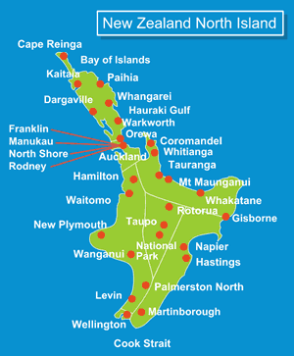
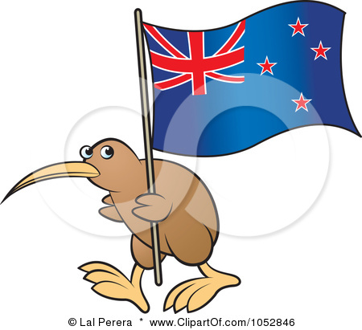
Te Ika-a- Māu

Slide 11
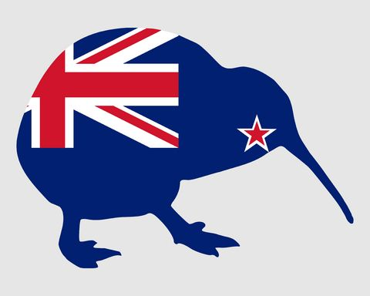
GDP :- US$102.863 billion , 79% of New Zealand GDP
Approximately 76% of New Zealand's population lives in the North Island.
12 cities are in North Island

Slide 12
Spectacular Natural Wonders in
New Zealand’s North Island

Slide 13
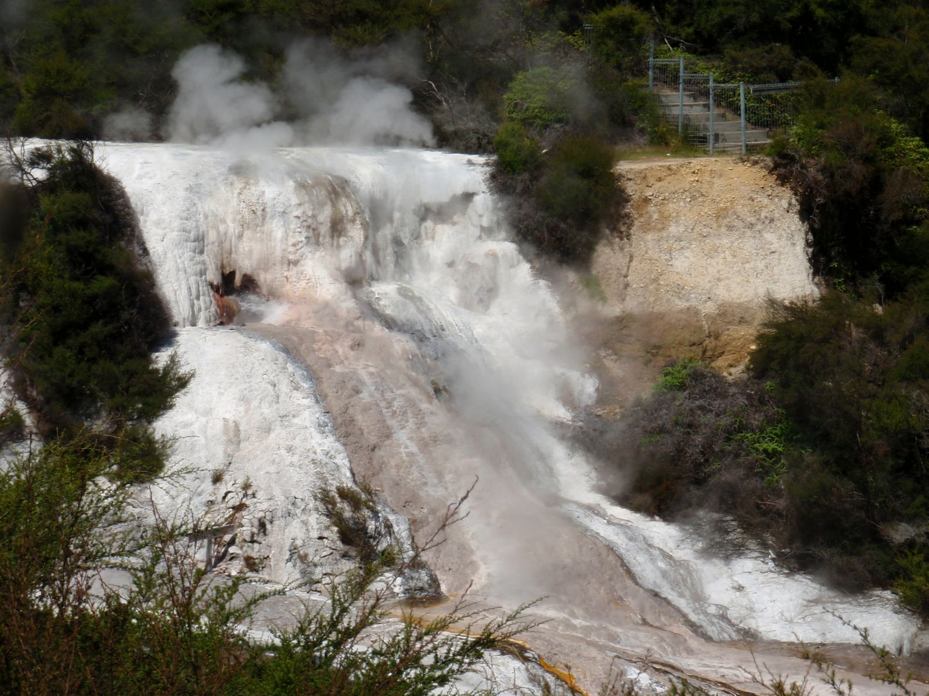
Hidden Valley (Orakei Korako)
The land of colorful silica terraces
and geysers
Place of Adorning

Slide 14
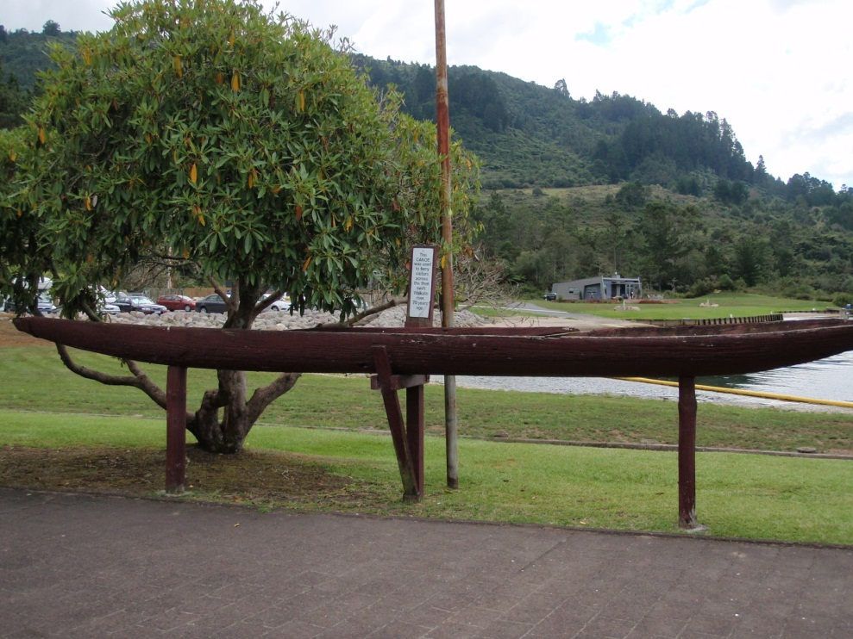
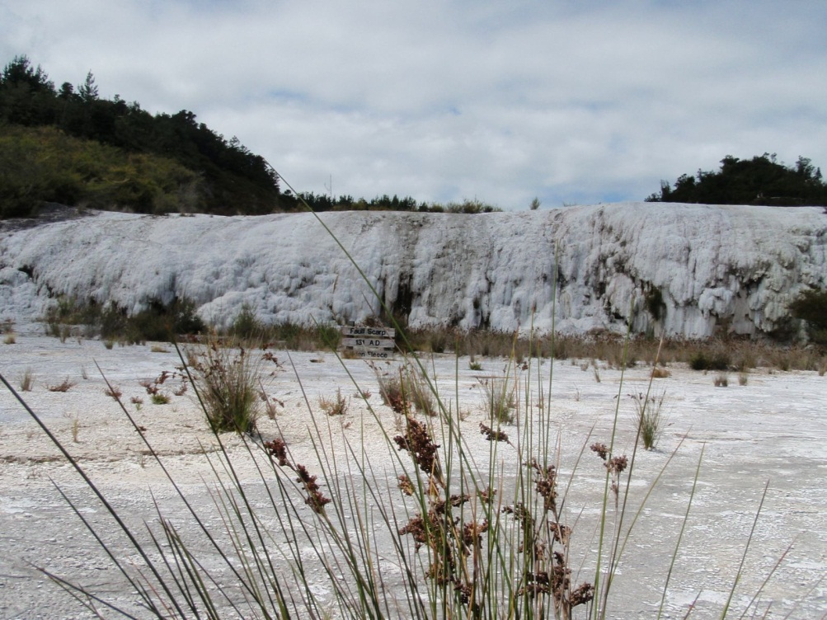
Use this canoe to cross the Ohakuri Lake to reach the Hidden Valley
Fault scarp of the silica terraces, formed 131 AD by a massive earthquake

Slide 15
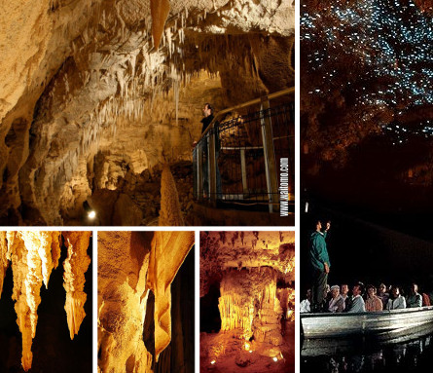
Waitomo Glowworm Caves
It is the home of many underground caves in the location
the most famous feature of the Waitomo caves is the glowworms!

Slide 16
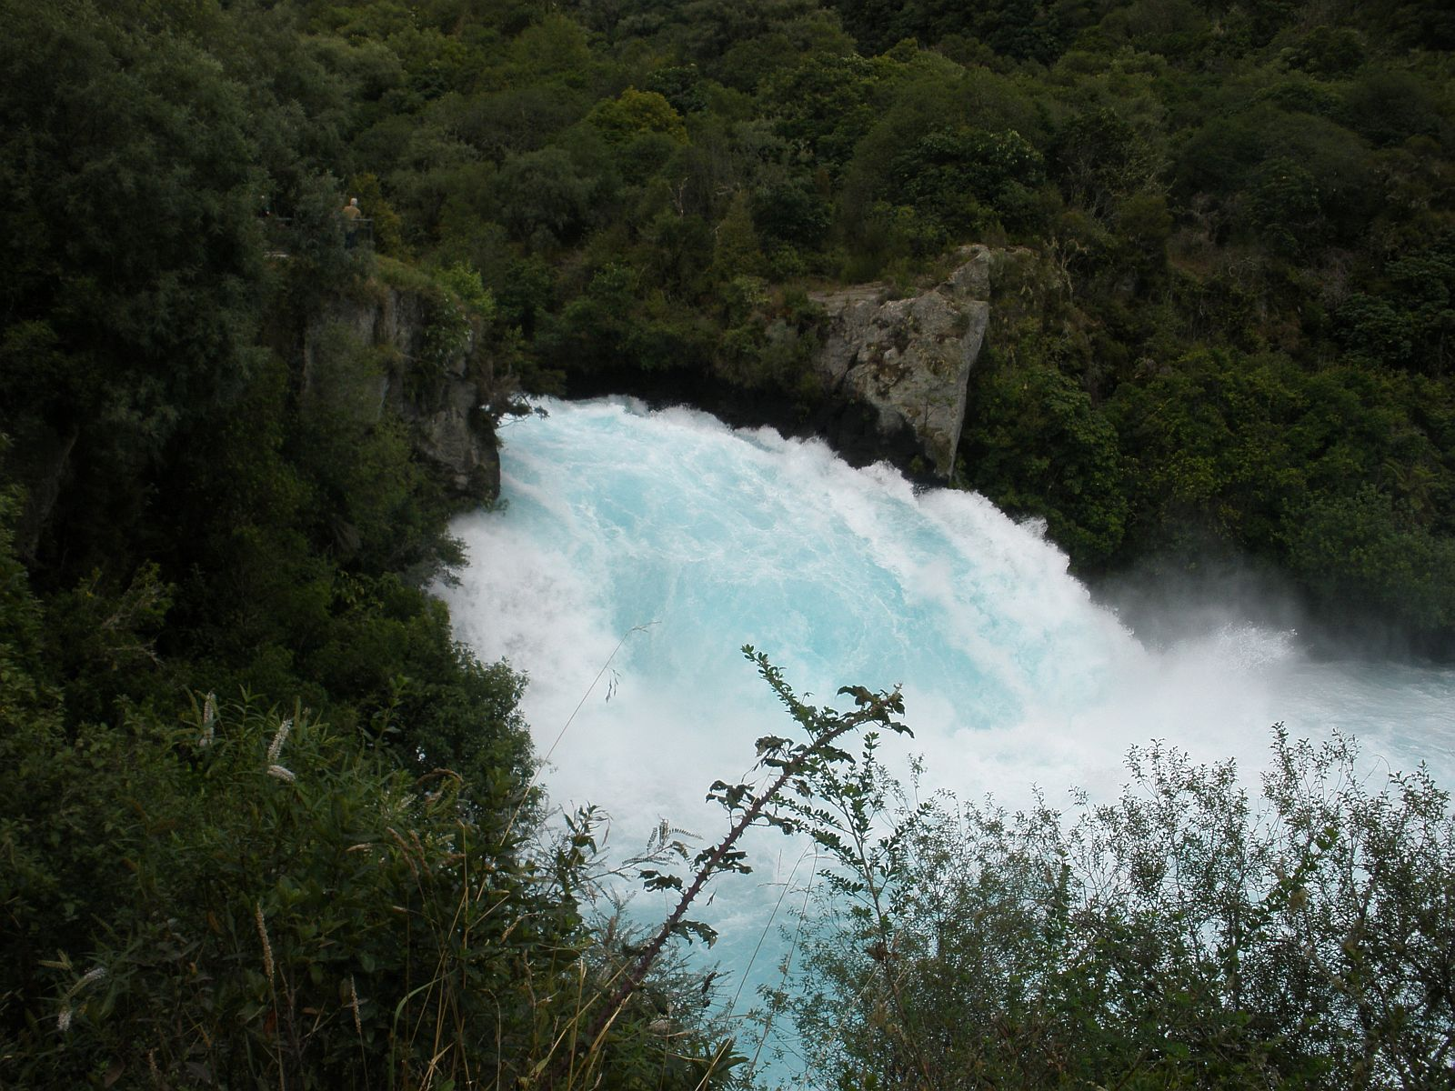
Huka Falls
Adventurous jet boat rides are available if you want to admire the falls from below.

Slide 17
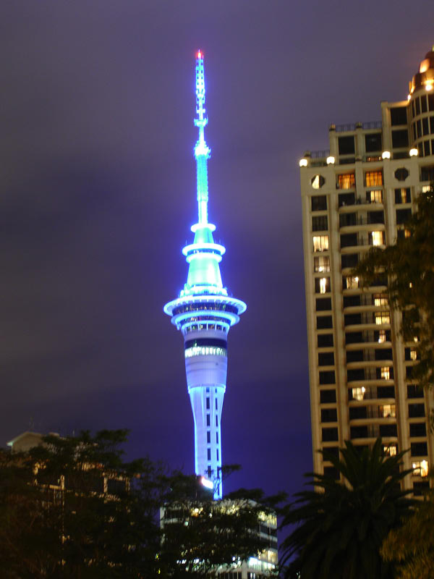
Auckland Sky Tower
It is an Observation and Telecommunication Tower
The tallest tower (freestanding structure) in the Southern Hemisphere

Slide 18
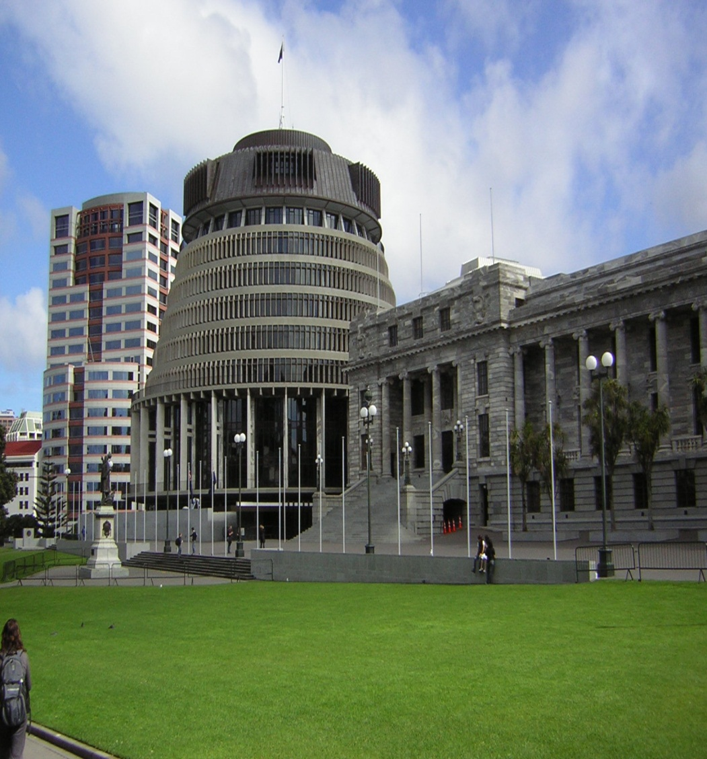
Parliament

Slide 19
Government
Queen Elizabeth II
Government based on west minister system
Head of government is prime minister
Queen plays only a formal role in the executive

Slide 20
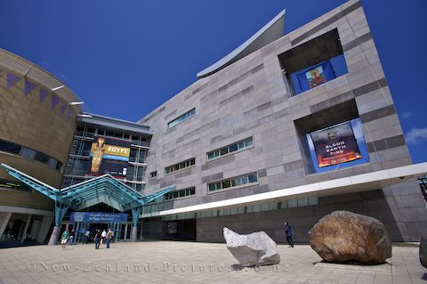
New Zealand Museum (Te Papa Tongarewa)
world of unique and authentic treasures and stories are found inside
museum take you on a tour of New Zealand's nature, art, history and heritage including the culture and wildlife.

Slide 21
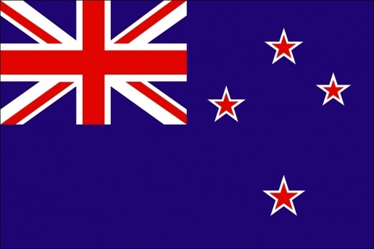
SOUTH ISLAND

Slide 23
GEOGRAPHY
Location- Oceanic
Area- 1,51,215km2
Length- 840km
Highest Elevation- 3754m
Highest Point- Aoraki/Mount Cook
Regions- 7
Territorial Authority- 23
Largest City- Christchurch

Slide 24
DEMOGRAPHICS
Demonym- South Islander
Population- 1,038,400
(As of June 2011)
Density- 6.9/km2
Ethnic Group- European, Maori

Slide 25
TOURISM
Tourism is a huge export earner for the South Island. Popular tourist activities in include
sightseeing,
Adventure tourism,
Tramping (hiking) and camping.

Slide 26
TOURIST PLACE
Canterbury (North)
Canterbury (South)
Christchurch
Otago
Fiordland
Marlborough
Nelson
Tasman
Queenstown
Southland
Wanaka
West Coast (North)
West Coast (South)

Slide 27
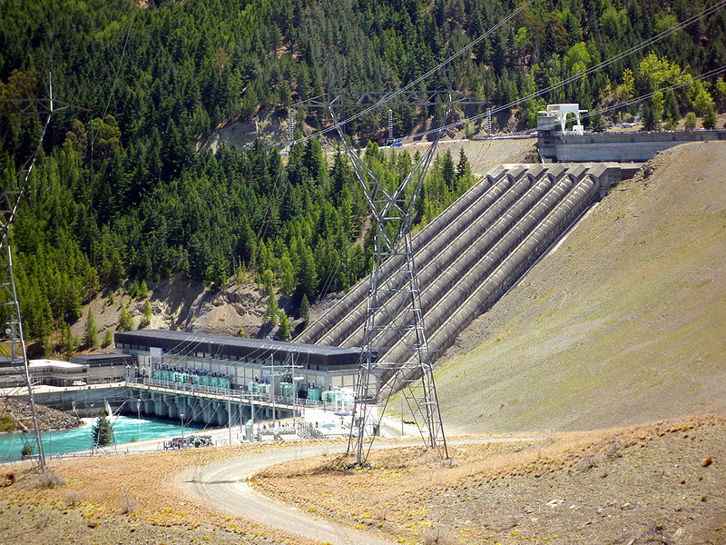
Benmore Dam is the largest of eight dams within the Waitaki power scheme and was commissioned in 1965

Slide 28
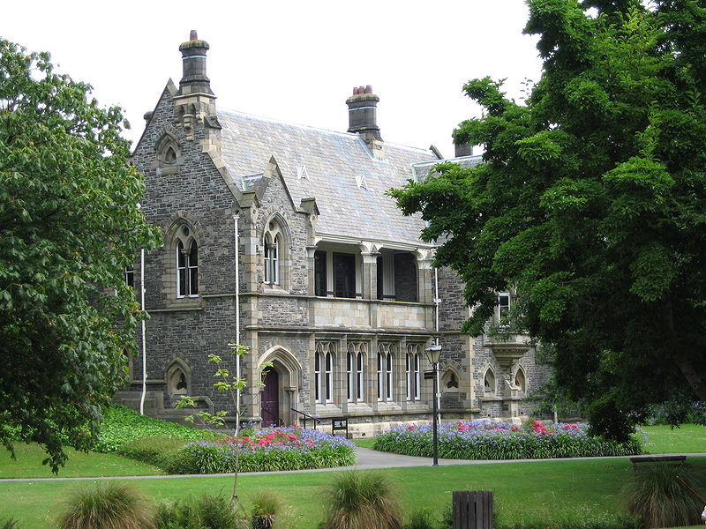
The Canterbury Provincial Council Building.

Slide 29
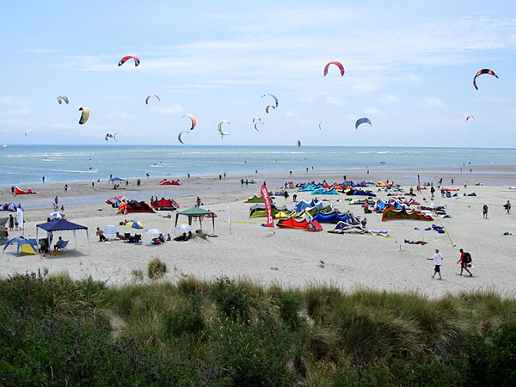
One of Nelson's beaches during a kite surfing competition.

Slide 30
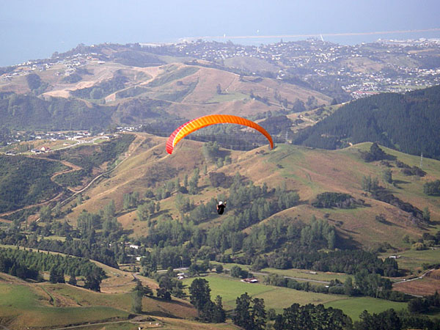
Paragliding over Nelson, South Island

Slide 31
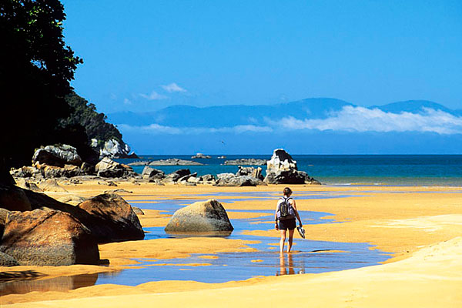
Abel Tasman National Park

Slide 32
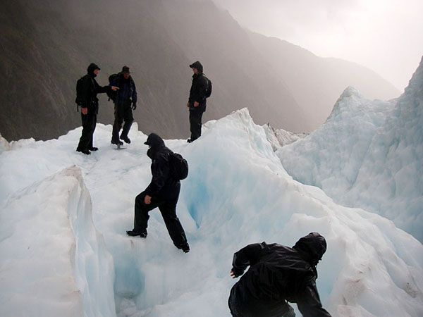
Glacier

Slide 33
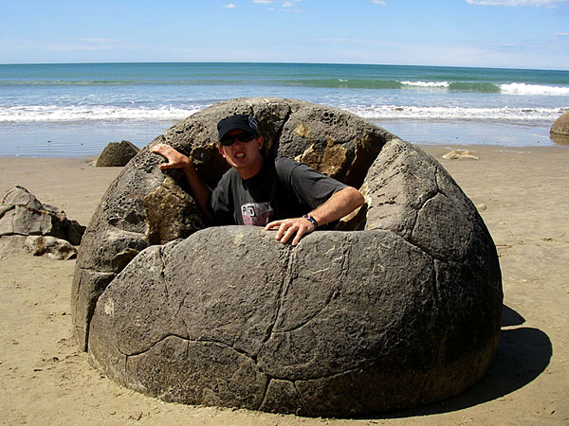
And on a beach, far, far away, giant exploded footballs

Slide 34
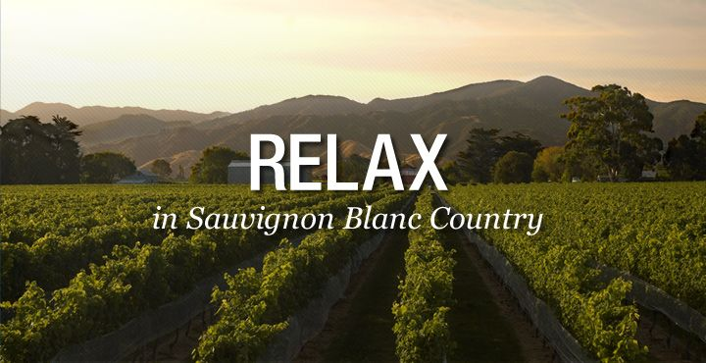
WINE
We’re world famous for our Sauvignon Blanc, the best in the world

Slide 35
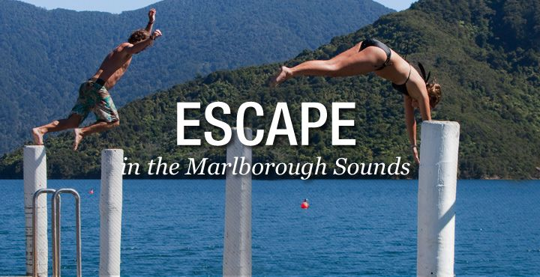
WATER
Get lost in the Sounds, a spectacular maze of coves, islands, and peninsulas.

Slide 36
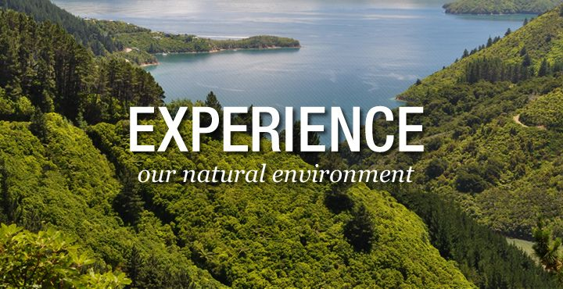
WILDERNESS
Walk or bike the legendary Queen Charlotte Track.

Slide 37
FESTIVAL

Slide 38
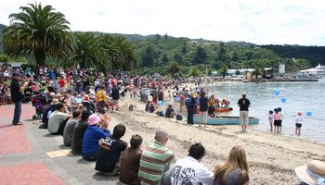
Picton Maritime Festival – 21st January

Slide 39
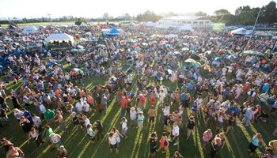
Blue, Brews and BBQ ‘s – 4th February

Slide 40
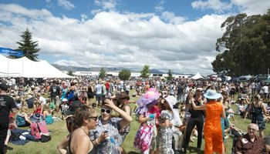
The Marlborough Wine Festival – 11th February

Slide 41
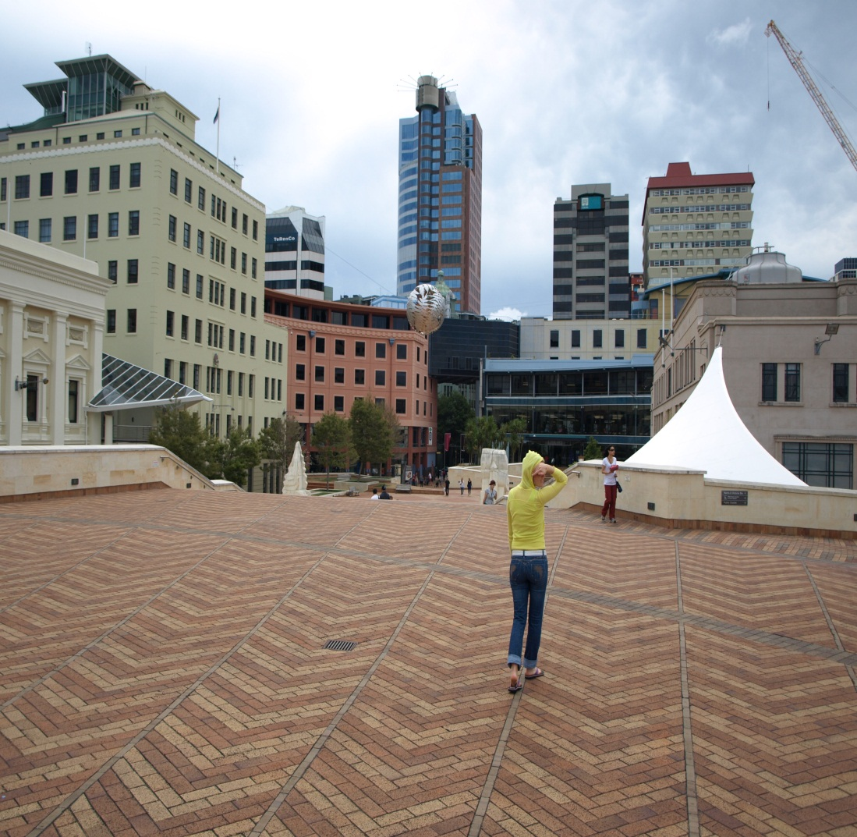
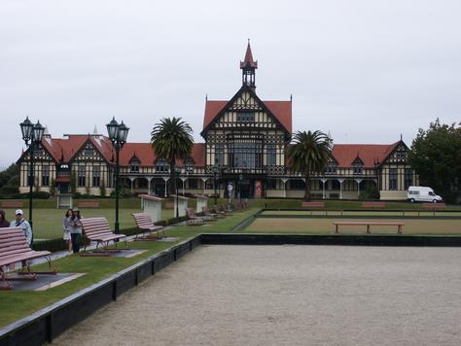
MUSEUM

Slide 42
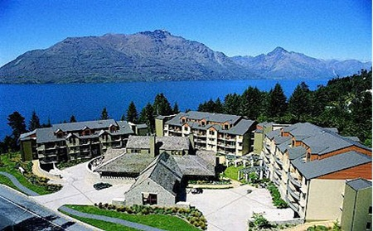
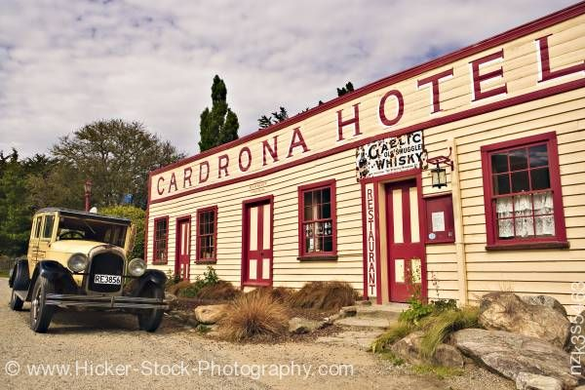
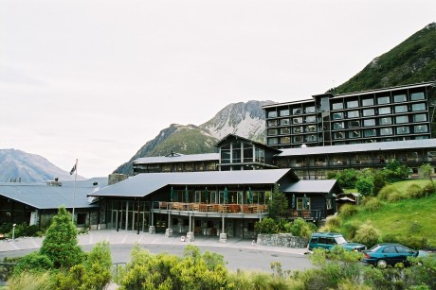
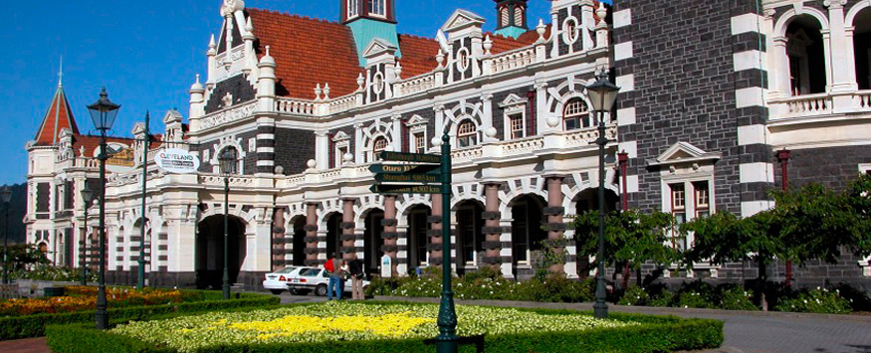
HOTEL

Slide 43
WHEN TO GO

Slide 44
The New Zealand summer (November through February) is the best time to visit the South Island—especially if you want to swim, sun, and boat on the north coast.
Temperatures during these months can get into the mid-70s during the day.
The one downside to traveling here during December and January is that schools are on break, so you'll be sharing the sights and hotels with lots of vacationing Kiwis.

Slide 45
TOURIST INFORMATION
www.newzealand.com
www.newzealand.com/travel/i-sites/i-sites_home.cfm
www.queenstown-vacation.com
www.nelsonnz.com
www.destinationmarlborough.com

Slide 46
MAORI CULTURE
&
HISTORY

Slide 47
HISTORY
10th Century A.D. - 1st people to discover New Zealand were from Eastern Polynesia.
Canoe Voyages brought people from Hawaiki – “ancestral homeland” to NZ over 100 years and they became the Maori tribes.
Canoes and their names were important in determining Maori’s geological history.

Slide 48
HISTORY
10th Century A.D. - 1st people to discover New Zealand were from Eastern Polynesia.
Canoe Voyages brought people from Hawaiki – “ancestral homeland” to NZ over 100 years and they became the Maori tribes.
Canoes and their names were important in determining Maori’s geological history.

Slide 49
CONT….
February 6, 1840 the Treaty of Waitangi was signed by over 500 Maori chiefs.
Became a British colony
Agreed that Queen of England would have sovereignty over their land because they had no national government or form of laws
She would protect them and they still get to retain possession of their land
However in the 1860’s, land wars began to erupt because the Pākehā people “white strangers” were trying to take their land.
Led to the Maori King movement – protecting lands by uniting under a paramount chief.

Slide 50
MAORI MYTHOLOGY
Until the 19th Century, Maori transferred history down the generations by word-of-mouth (Especially through song and dance)
The Beginning – Nothingness and after nine nothingness's became the dawn. From the womb of the darkness came the Sky father and the Earth mother. They had 6 children: god of the winds, god of the forest, etc… They separated their parents and there became light. All the children were male so the sky father created a woman out of soil.

Slide 51
Maori Culture
Means ordinary or usual. They call themselves “people of the land”
Pastoralists – grow crops such as Kumara – sweet potato
They are ruled by tribal chiefs
Hierarchical society
http://en.wikipedia.org/wiki/Maori

Slide 52
CULTURE
Headed by chiefs, followed by priests, then by commoners, and then slaves. Ariki’s are their leaders within their tribes - gain authority through genealogy and Rangatira are the aristocracy of their society and are the children of the Ariki. Usually male figures.
The extended families lived together in huts grouped into villages anywhere from a few to 500 households. The families were sub tribes that are a part of a wider tribe which established their social structure. Each tribe had the same ancestor that came from Hawaiki on a certain canoe.
This determined marriage, settlement patterns, and who fought whom.

Slide 53
WARFARE
Intertribal warfare are essential parts of their culture.
It was their way of gaining control of their land.
After defeating a tribe, they either eat the defeated (ultimate insult) or they take the women and children to be their slaves.
Their weapons consisted of long or short wooden clubs resembling spear, but are not thrown.

Slide 54
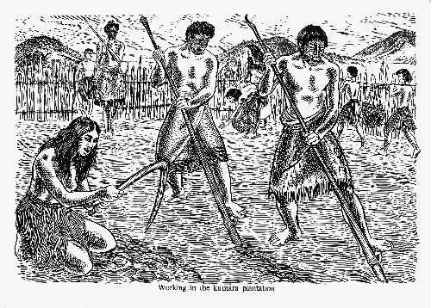
DAILY TASKS
Men – prepare agricultural plots, fish in the open sea, dive for shellfish, only ones allowed to go to war, build canoes and tattoo and carve.
Women – do the planting, bring food out to men when fishing, only ones allowed to cook, weave and make cloaks.
The final say in family matters rested on the male head of the household.
Delineation of responsibility was ruled by the complex laws of tapu (taboo)
Boy children are taught to be warriors, girl children help their mothers with household chores.

Slide 55
KEY VALUES OF THEIR CULTURE
Spirituality – everyone has an active life force, soul and spirit, and personal spiritual prestige and power.
Land – Mountains and rivers delineated tribal boundaries. Mountains were personified and became part of their social identity.
Hospitality – People are the most important things in the world. Important part of Maori Society
Ancestors – Proper reverence to ancestors is important. Genealogy has to be committed to memory
Largely a collective society, not individualistic

Slide 56
MARAE- ANCESTRAL HOUSE
Where Ancestral spirits live – sense of home
Meeting house that is the link between sky father and earth mother.
Visitors assemble outside gates and women call them to come in (do Karanga). All visitors are challenged by the male Maori making fierce faces and noises showing that they are ready for war. Visitors then show that they come in peace. Shoes have to be taken off and they give a gift.
Bongi – traditional pressing of noses (mingles breath showing unity)

Slide 57
DEATH
A body should not be left on it’s own after death. They place them on the marae where it can be watched over by their relatives until burial.
They will leave the coffin open so they can touch and weep over the body in order to relieve emotional pain.
The funeral speeches are made directly to the body because they believe that the spirit does not leave the body till burial
Dead bodies of chiefs are left exposed on platforms until flesh rots and they take certain bones and clean them and paint them red and put them in a burial chest and placed in a cave or other sacred sites.

Slide 58
FOOD, CLOTHING AND ART
Cook food in earth ovens – dig a pit with wood and stones on top – heat stones
Maori delicacies – freshwater eels, mutton birds, and seafood
Paper Mulberry plant is used for making tapacloth. This is what they make clothing with.
Tattooing – Used for decoration – long painful process with a bone chisel and pigment rubbed on incision. Men are heavily tattooed – face, body, bottom, and thighs. Women’s are confined to chin and lips and sometimes ankles and wrists.
Song and Dance – Their dances are associated with war chants that preceded battle. Includes fierce shouting, flexing arm movements, thunderous stomping, big eyes, and sticking out of the tongue.
Musical Instruments – 2 forms of flute (one you play with your mouth and one with your nose) and also a trumpet (shell with a wooden mouthpiece. Used no drums just rhythmic stomping

Slide 59
REFERENCES
Hanna, N. (1999). Fodor’s Exploring New Zealand. New York: The Automobile Association.
Harding, P. (2002). New Zealand. Melbourne: Lonely Planet Publications.
Māori: Wikipedia, the free encyclopedia. (2005, October 18). Retrieved
October 13, 2005, from http://en.wikipedia.org/wiki/M%C4%81ori
Roselynn, S. (1998). Cultures of the World: New Zealand. New York: Times Editions Pre Ltd.
Royal, T. A. C.(2005, July 11). 'Māori' Te Ara - the Encyclopedia of New Zealand. Retrieved October 13, 2005, from http://www.teara.govt.nz/NewZealandInBrief/Maori/en

Slide 60
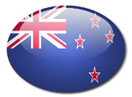
The Maori are the native inhabitants of New Zealand and are of Polynesian origin numbering over 500,000 today. This is about 15% of New Zealand's population. Over 95 percent of Maori live on New Zealand's North Island.
Evidence suggests that the Maori originally immigrated to New Zealand probably around 1200 AD from the Cook Islands, Society Islands, and Marquesas Islands in the Pacific Ocean. According to Maori legend, their ancestors set out together from a place in Polynesia in a fleet of large canoes. Before the arrival of European colonists in the late 18th century, the Maori had settled throughout New Zealand.
In 1841 New Zealand officially became a colony of Britain. Many European settlements were established and between 1843 and 1872 violent conflicts between the Maori and European colonizers, known as the New Zealand Wars took place.
After the New Zealand Wars, some Maori lands were confiscated illegally and during this time the Maori population declined rapidly as a result of the wars and European diseases.
Today the Maori have generally adjusted well to western culture and the population has increased substantially. Since 1980 the Waitangi Tribunal, a government body established to settle legal claims based on the 1840 Treaty of Waitangi, have engaged in recompensing Maori for land that was illegally confiscated.
formation

Slide 62
ECONOMY
&
BUSINESS

Slide 63
New Zealand Economy Profile
GDP:
Official Exchange Rate: 2.1013 NZD over this period ( 3rd Jan 2012).
Growth rate: 0.8 %
Labour force by occupation:
Agriculture: 7%
Industry: 19%
Services: 74% (2006 est.)
Investment (gross fixed)
19.5% of GDP (2010 est.)
Budget:
Revenues: $54.82 billion Expéditeurs: $62.3 billion (2010 est.)

Slide 64
New Zealand Economy Profile
Inflation rate (consumer prices):
2.3% (2010 est.) 2.1% (2009 est.)
Central bank discount rate:
2.5% (31 December 2009) 5% (31 December 2008)

Slide 65
Top 10 Companies in New Zealand
Name | Code | Aug 2007 Capitalisation (NZD million) | Nov 2008 Capitalisation (NZD million)
Auckland Airport Ltd | AIA | 1873 | 1062
Air New Zealand Ltd | AIR | 506 | 223
AMP Ltd | AMP | 513 | 247
Australia & New Zealand Banking Limited (ANZ National Bank Ltd) | ANZ | 708 | 317
APN News & Media Ltd | APN | 920 | 585
AMP Ltd NZ Office Trust | APT | 522 | 785
BIL International Ltd | BRY | 62 | -
Caliver Corporation Ltd | CAV | 124 | 66
Contact Energy Ltd | CEN | 1957 | 1014
Ebos Group Ltd | EBO | 172 | 193

Slide 66
Government Policy on FDI
Foreign investment into New Zealand is encouraged, however sensitive assets are protected by the Overseas Investment Act 2005.
Overseas Investment Office consent is required for the acquisition of significant business assets (exceeding $100 million), sensitive land (non-urban land of more than 5 hectares, offshore islands, land adjacent to lakes and the foreshore, or land of conservational or historical significance) and fishing quotas

Slide 67
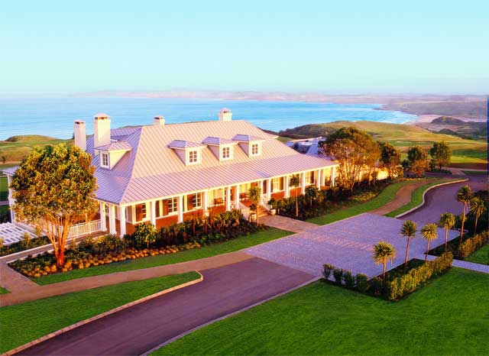
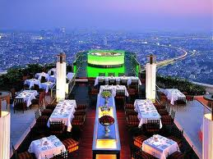
Hospitality Industry:
More than 135,000 people work in the hospitality industry in New Zealand
Recession affects demand for staff in some areas of hospitality
Job opportunities in hospitality beginning to improve

Slide 68
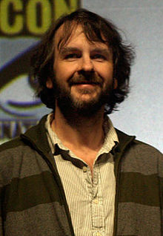
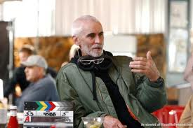
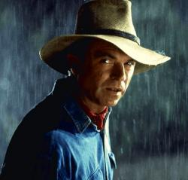
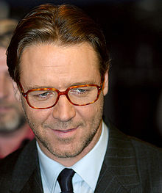
Entertainment: Film Industry
Peter Jackson
Lee Tamahori
Neill
Russell Crowe

Slide 69
Popular films
S. No | Movie | Director
1 | The Adventures of Tintin | Steven Spielberg
2 | Avatar | James Cameron
3 | 10,000 BC | Roland Emmerich
4 | X-men Origins | Gavin Hood
5 | Lord of the Ring | Peter Jackson

Slide 70
THANK YOU

